Slide 1
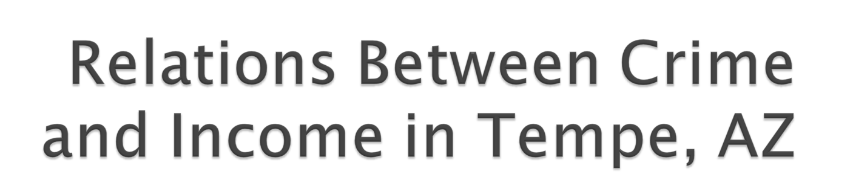
John Bonifas, Randy Ferrin

Slide 2
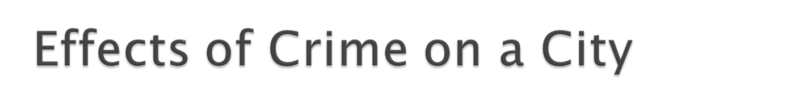

Crime inflicts many costs on a city’s residents, including but not limited to:
Feelings of a lack of security and safety
The monetary value of property loss from criminal acts
Lost earnings
Insurance rates
Lower property values

Slide 3



Will crimes rates in a particular area of Tempe, AZ be significantly affected by the average household income of that particular area?
?
=
Notes:
In other words, will crime be rampant in low-income areas, and otherwise uncommon in wealthier areas of town?

Slide 4

The connection between income and crime rates is directly related to the basic human instinct of envy (Glaeser et al.)
Lower-earning census tracts have significantly higher rates of felonies, especially drug-related felonies (Rundle et al.)
Areas with low socioeconomic status have significantly higher crime rates (Addy et al.)

Slide 5


Notes:
If our project agrees with our prior research into similar projects, then we will see a large and rather complex relationship between median income in a particular area vs. the crime rate in that particular area.

Slide 6

Given a significant difference in median household income between two areas, we will see significantly more crime in the area with a lower median household income.

Slide 7

Crime data from Elyssa
Income data from the US Census Bureau
Applicable shapefiles from the US Census Bureau

Slide 8

Using income data from the US Census Bureau, we calculated the average household income from each census tract in Tempe.
Low: Tract 319101 - $23,688
High: Tract 319907 - $145,883

Slide 9
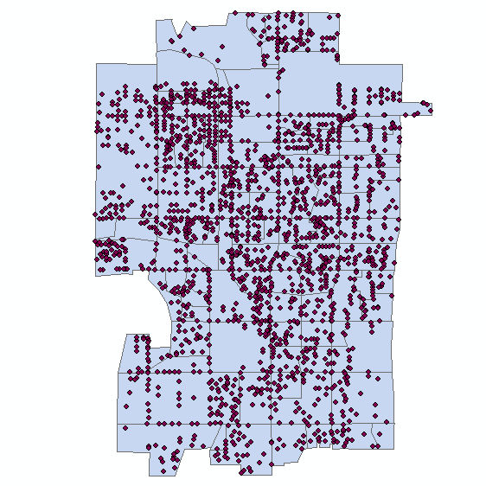
Notes:
After geocoding our list of crimes, we came up with a map showing roughly 8,500 crimes which occurred within the city of Tempe in 2010.

Slide 10
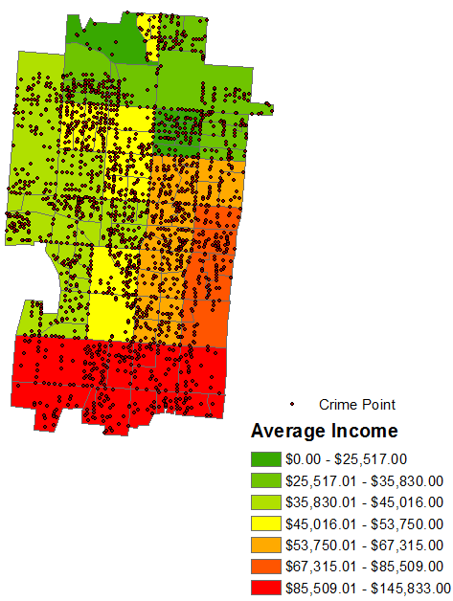
Notes:
The northern and western regions of Tempe have low average household incomes, whereas the eastern and southern regions of Tempe have relatively high household incomes. As you can see, most of the crimes appear to be centered in the lower income areas…

Slide 11
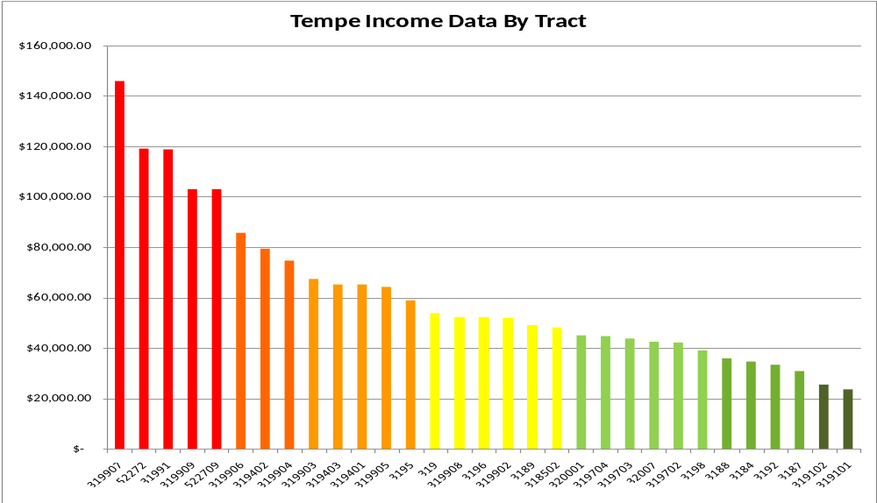

Slide 12
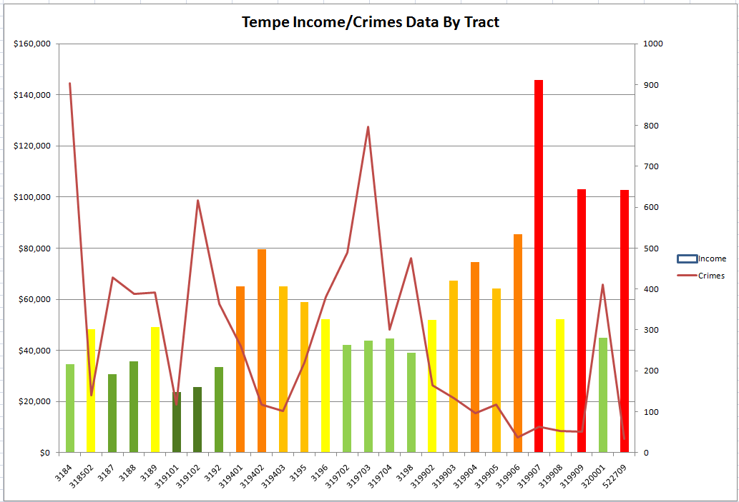

Slide 13

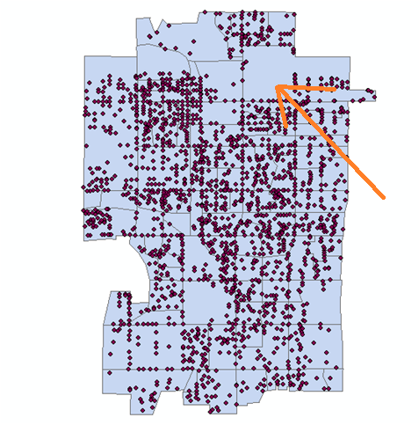
We see one particular area of Tempe where interestingly there seems to be little to no occurrence of crime.
Reasons for low crime rate may include increased police presence, etc.

Slide 14
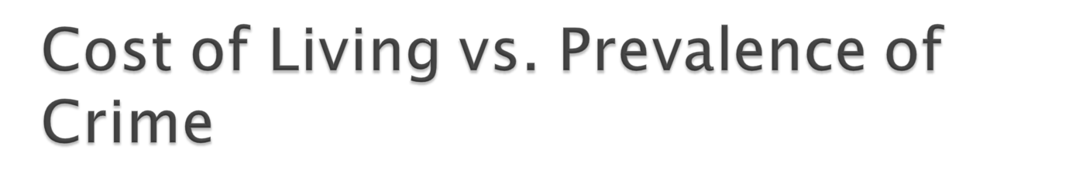
The poverty line for a family of four in the United States in the year 2010 was $22,050.
Tract | Average | Number of Crimes | PercTotal
319101 | $23,688.00 | 118 | 1.40%
319102 | $25,517.00 | 617 | 7.29%
3187 | $30,670.00 | 429 | 5.07%
Total |  |  | 13.76%
Notes:
The three census tracts within $10,000 of the poverty line accounted for a total of 13.76% of all Tempe crime (out of a total of 32 tracts).

Slide 15
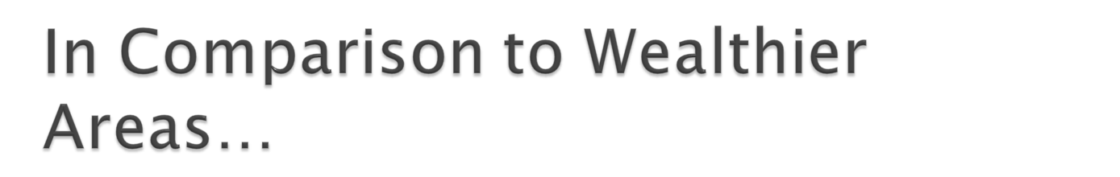
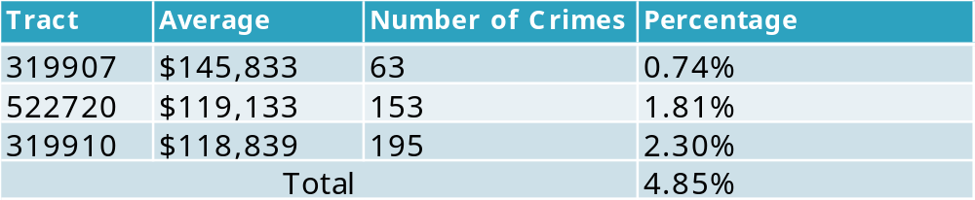
Notes:
While the three census tracts with the lowest incomes accounted for 13.76% of crime, the three census tracts with the highest incomes accounted for 4.85% of the total crime in Tempe.

Slide 16
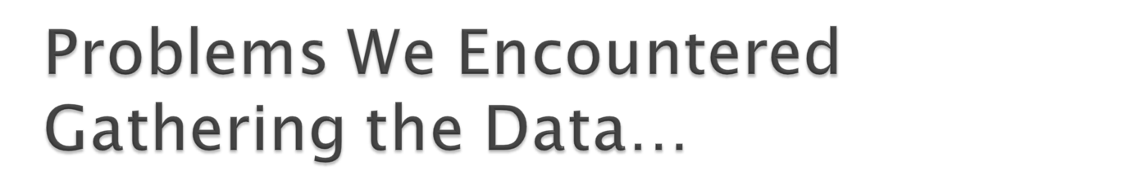
Finding the data in the first place
Manipulating the huge U.S. Census 2010 datasets (one in excess of 400,000 records)
Learning the U.S. Census TIGER Shapefile relationships
Notes:
We first went to the U.S. Census FTP Site, and the ASU GIS Library. They had the crime data, but only by voting district, not by block or tract. They also did not have income data by block or tract. Elyssa assisted us here by querying her sources and providing the missing data. Then the data for the 2010 Census became available in late March, but the datasets were so huge that they were very difficult to manipulate. Elyssa came to our rescue again with her geocoding skills in Arc10. I also imported some of the data into SQL server and created a street/block/tract lookup table which helped immensely. Also, I found the technical spec for the TIGER shapefiles, which helped a lot when I was learning the relationships between the TIGER tables.

Slide 17
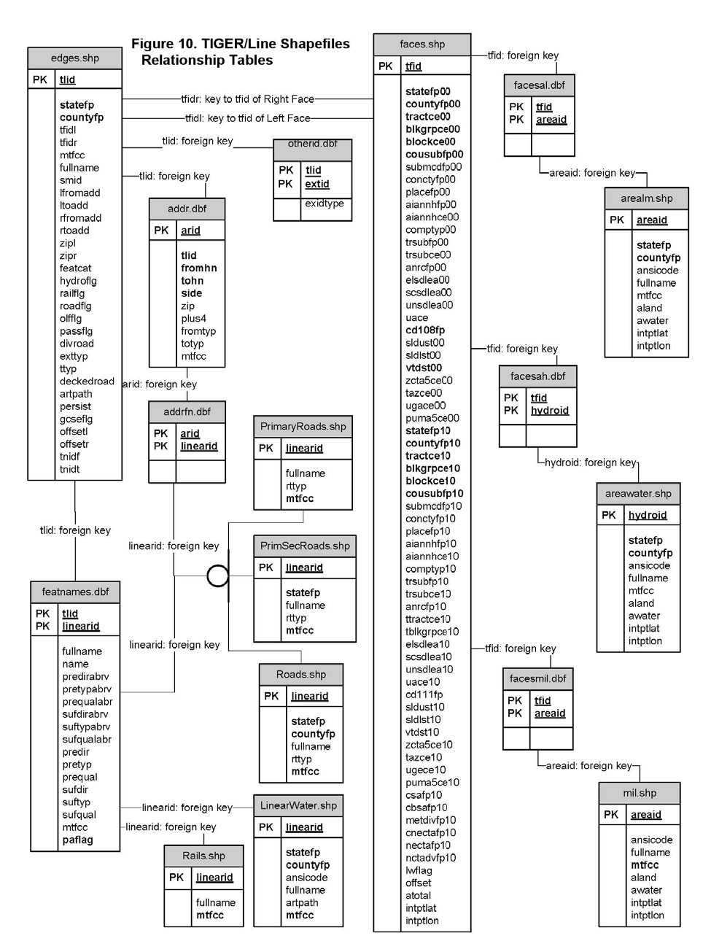
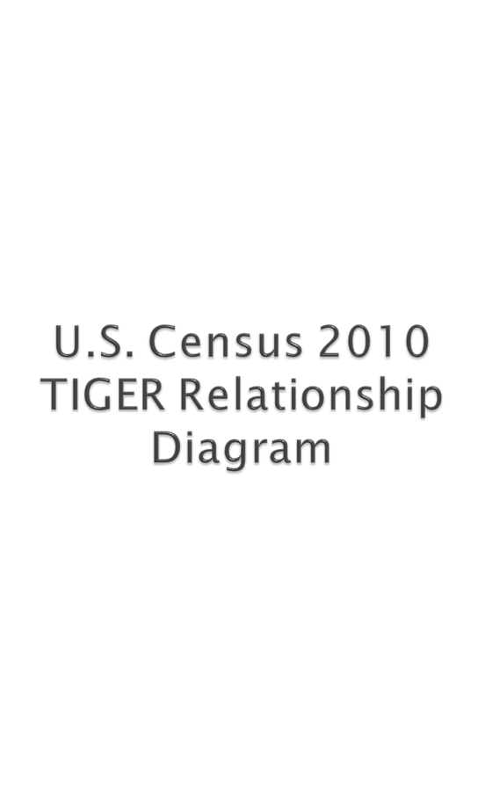
Notes:
Our crime data was by address and street. Our income data was by tract. As you can see, one cannot just join street to tract. One has to make several joins and relates to get the address/street join to tract to work. And thus, Elyssa’s Arc10 geocoding was necessary.

Slide 18
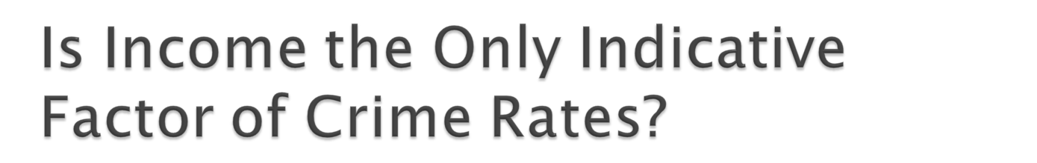
According to the FBI, the major factors behind crime rates in a particular area include (but are not limited to):
- Racial/ethnic makeup
- Age and gender composition
- Education levels
- Family structure (Dual-parent vs. single-parent households)

Slide 19

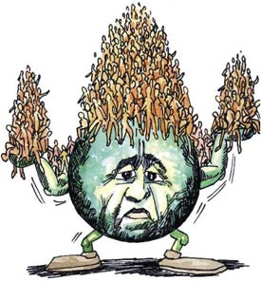
Do the other factors mentioned earlier in our presentation contribute significantly to crime levels?
Does the population in an area contribute significantly to crime rates (i.e. more people = more crime)?

Slide 20

Crime rates are significantly higher in areas which average household income is below the city average ($61,232).
The census tract with the highest number of recorded crimes was 3184, with 903 crimes and an average income of $34,489.
The census tract with the lowest number of recorded crimes was 552709, with 34 crimes and an average income of $102,868.

